Slide 1
Preference Selection, a quick guide
CHEM lecture course preference sites close on: Thursday, January 17 at 8:00 AM.
CHEM laboratory preference sites close on: Wednesday, January 16 at 8:00 AM.
SPRING 2013

Slide 2
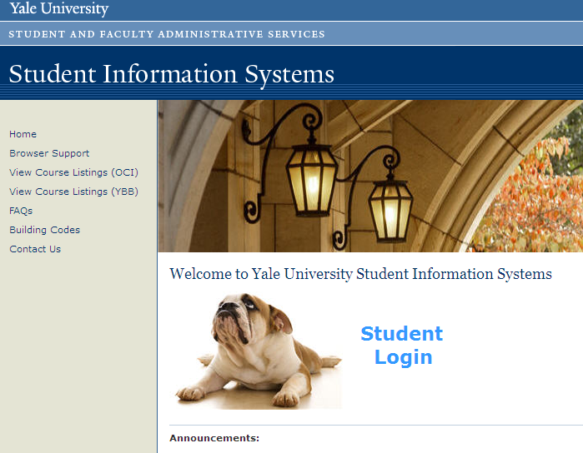
Go to SIS (www.yale.edu/sis)
Click Student Login

Slide 3
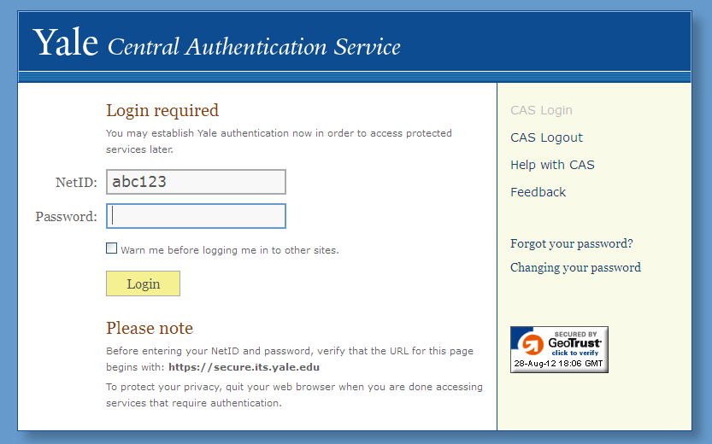
Log into CAS

Slide 4
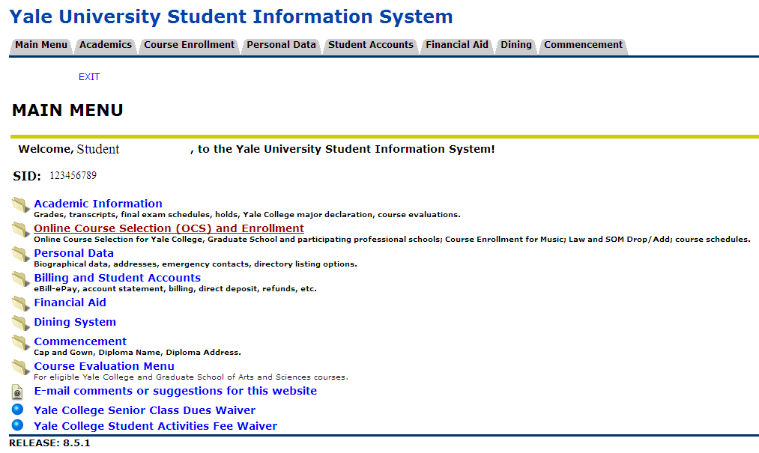
Click OCS & Enrollment link

Slide 5
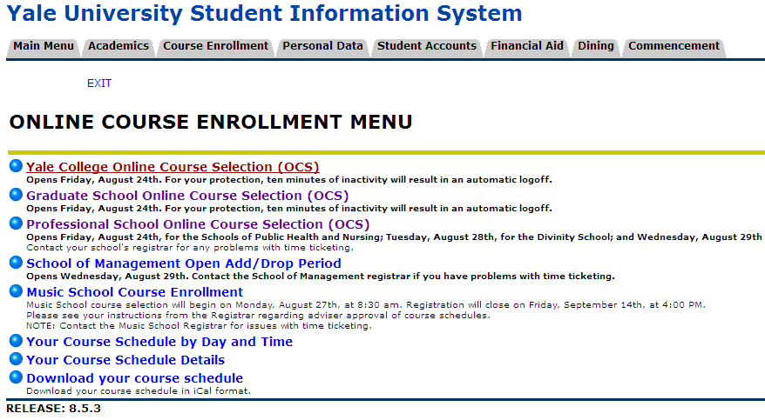
Choose Yale College’s OCS

Slide 6
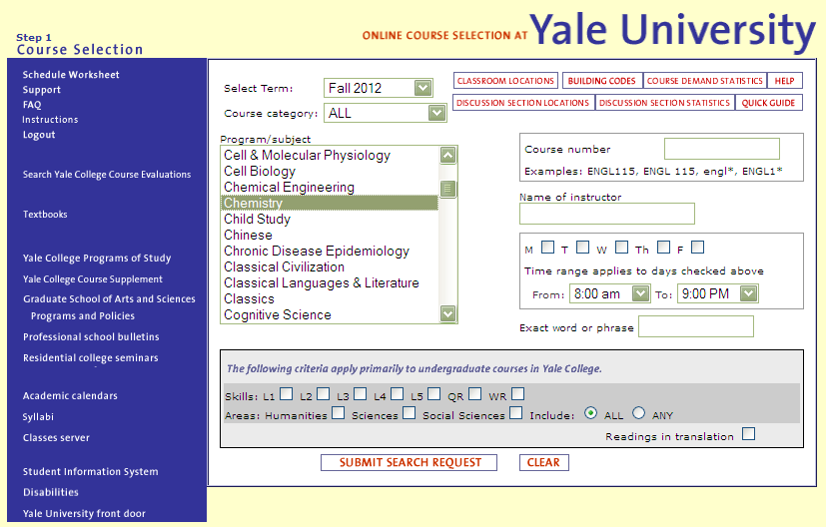
Choose Chemistry under Program/Subject

Slide 7
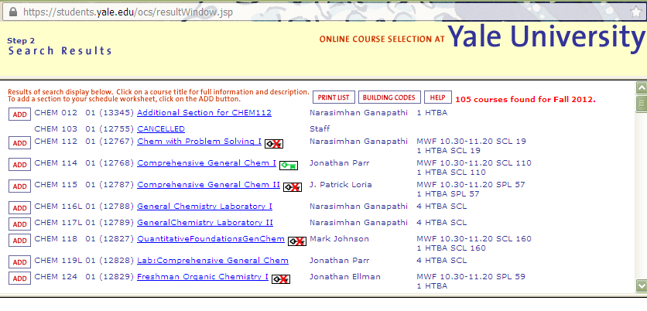
You will see all CHEM courses. Issues with placement? Come to advising hours (1:00-4:00 PM in SCL 1)

Slide 8
This green key means that you are allowed to take this course.

Slide 9
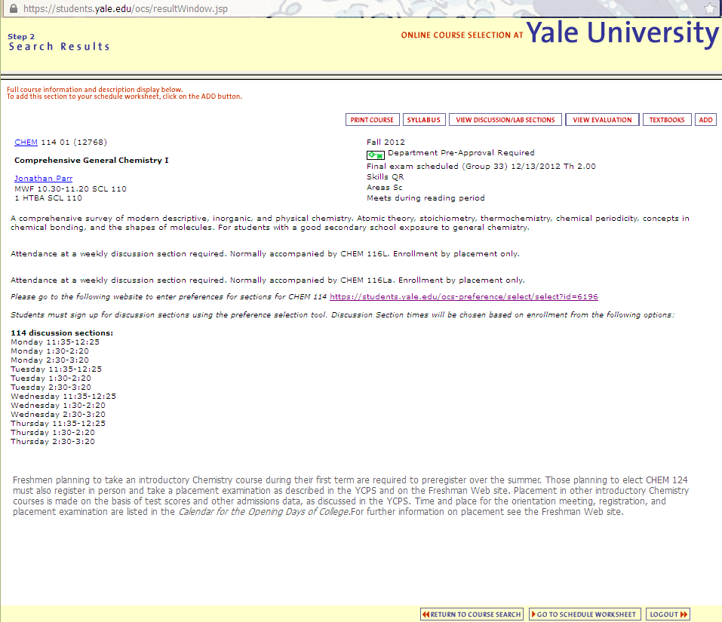
Click green keyed course to see description.
Click Preference Link - HERE!

Slide 10
Log in again…

Slide 11
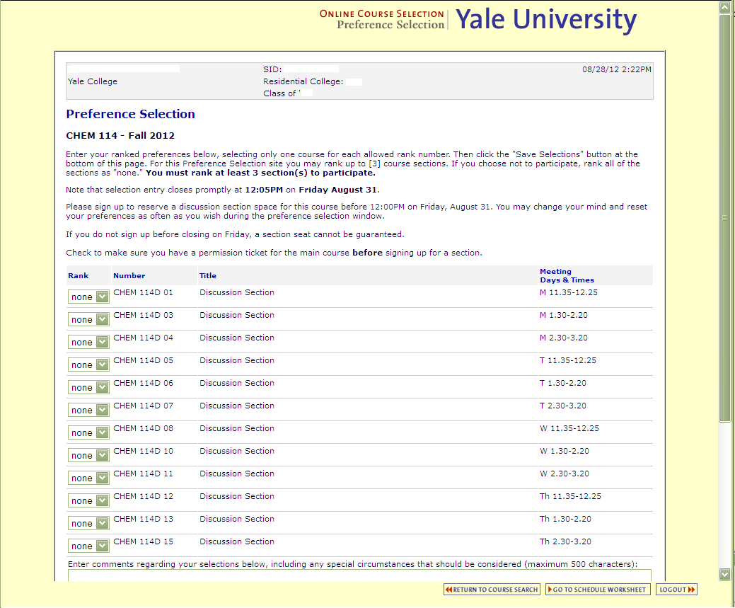
Here is Preference Selection!!!

Slide 12
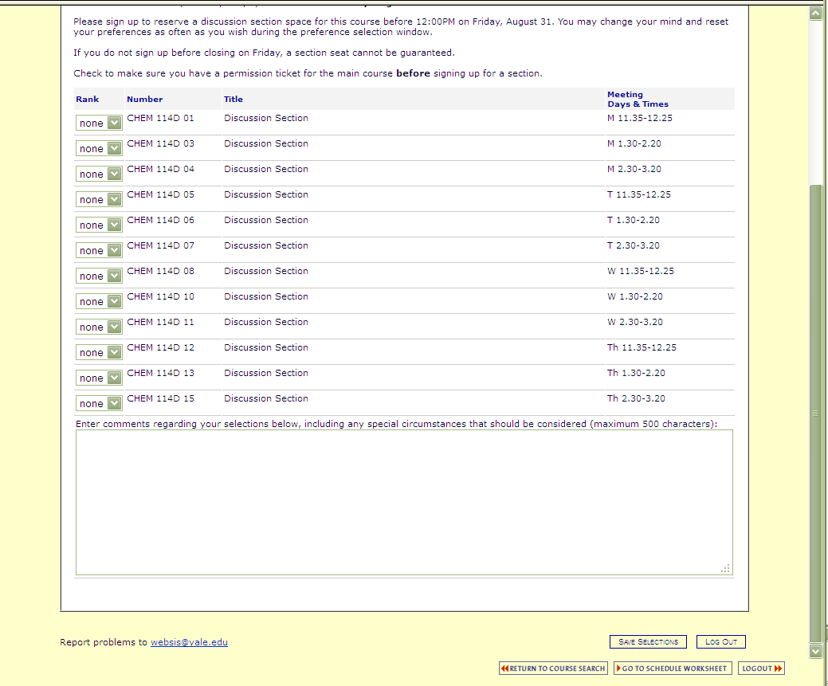
Don’t forget to scroll down to see ALL your options.

Slide 13
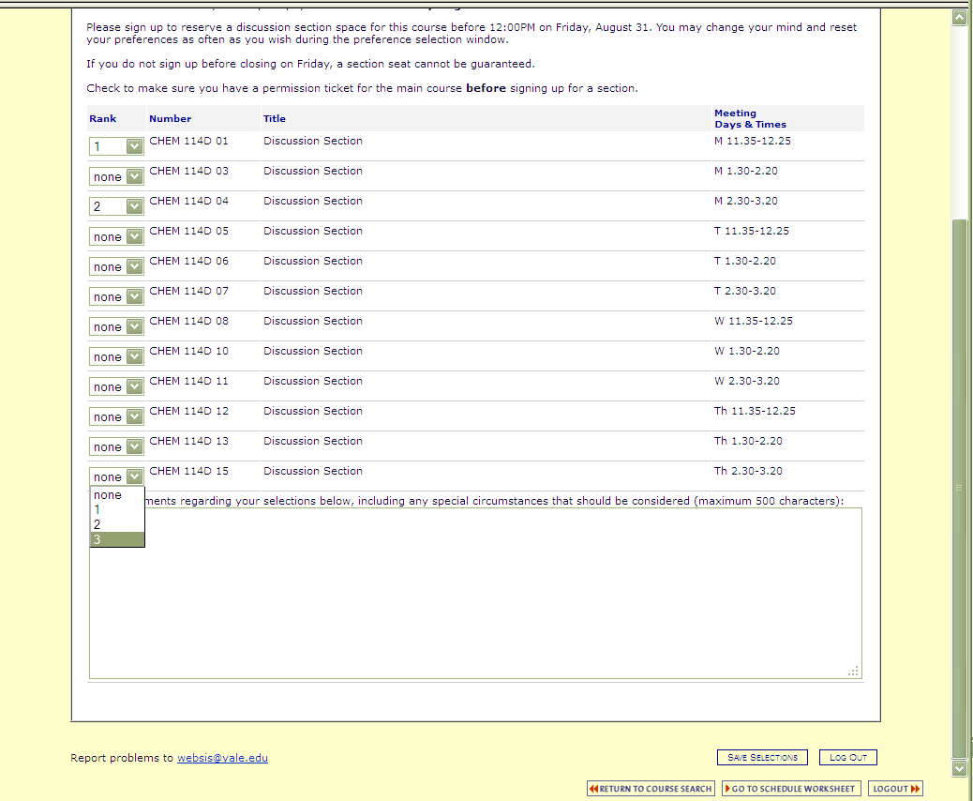
Enter your top 3 choices.
Don’t forget to Save!

Slide 14
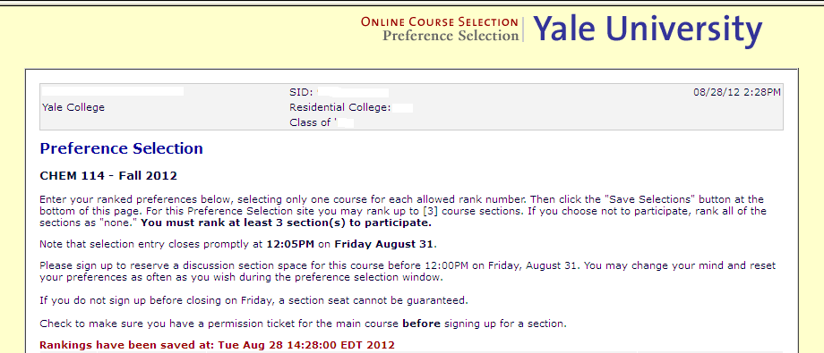
SUCCESS! 2012-03

